Slide 1
INSTRUCTION SLIDE, DELETE BEFORE PRESENTING
Pluralsight Instructor
Presentation
Template
To make a copy of this presentation template, click File > Make a copy. You can rename the copy, change where you save it in Drive, and start working on your presentation.

Slide 2
INSTRUCTION SLIDE, DELETE BEFORE PRESENTING
Please read before using this deck
Use this deck as a guide when preparing your class materials.
There are certain elements we want to include in every Pluralsight course. As you look through this deck, review the speaker notes below each slide. These will indicate whether a slide is mandatory. As well, we’ve provided a sample script for each—to illustrate key points we want to convey.
Thank you for your help in supporting a unified Pluralsight message.

Slide 3

INSTRUCTION SLIDE, DELETE BEFORE PRESENTING
Typography
Colors
The official typeface for Pluralsight company presentations is Montserrat. Click to download
If both words below look the same, then you’ve successfully installed the font. Hooray!
Use color carefully and minimally.
Primary colors
Pluralsight
Slide usage
The following slides serve as an example of how to use the slide layouts provided. Most slides are available in the Pluralsight core colors as shown here. In addition to text, there are several graphic elements provided to add flavor and personality to your presentation. They can be found at the end of the slides, and should be used strategically and sparingly.

Slide 4


Slide 5

Introduction to Python
Welcome!
First Name Last Name
Instructor, Pluralsight
Notes:
Mandatory
ACTION: Adjust title to fit your course.

Slide 6

Dave Wade-Stein (he/him)
About Me:
Bullet 1
Bullet 2
Bullet 3
Bullet 4
Bullet 5
Notes:
Mandatory
ACTION: Adjust to fit you.
Script: I am [insert name] with DevelopIntelligence. We’re the training partner for [insert client name]. [Provide brief info on your background.]
Wing it!!! Keep it short!!! (Under 2 minutes; less than 1 is even better). Your goal is to establish rapport. You’re just trying to connect with the students. For example...
Here’s a little about my background in case you want this for reference later. Fun fact: [insert a piece of trivia about your personal life…”When I’m not teaching or coding, I am a skydiver”…whatever cool hobby you are engaged in]
Avoid putting your resume here. Say only a sentence or two about your professional credentials and invite them to ask questions about your background or experiences at any point during the training.

Slide 7
Prerequisites
This course assumes you
Know how to program in some other language
Have never taken a formal course in Python and know little or nothing about the language
Please note:
If you have never programmed before or if you’ve only used Bash, Powershell, SQL or similar, this is probably not the right class for you.
Please chat me so we can get you to the right resource.
Notes:
Mandatory
ACTION: Adjust prerequisites to fit your course. Keep it brief.
Script: Before we start, I want to make sure everyone is in the correct class. Take a look at these prerequisites and message me in Chat if you have questions or aren’t sure you’re in the right spot.

Slide 8
Why study this subject?
To enhance your productivity in the DevOps world
In order to create an entrée in the world of Data Science
So that you can work on the Gazornin project
Notes:
Mandatory
ACTION: Adjust benefits to fit your course.
Examples...
You’ll be learning Python so that you can work on XYZ project…

Slide 9






































We teach over 400 technology topics.
Notes:
Mandatory
Script: Pluralsight teaches a lot of different tech. If there’s a technology you want to learn and you don’t see it in your company’s learning catalog, let your manager know. We’d be glad to help.”

Slide 10



You experience our impact on a daily basis!
Notes:
Mandatory
Script: In your everyday life, you come across tech many times a day. When you shop online. When you pay for your morning coffee. When you watch a movie or travel. We train software developers and IT professionals who work on many of the products and services you use daily.
In fact, when you talk on the phone, watch a movie, connect with friends on social media, drive a car, fly on a plane, shop online, and order a latte with your mobile app, you are experiencing the impact of our solutions.

Slide 11
My pledge to you:
I will..
Make this course interactive
Ask you questions
Ensure everyone can speak
Create an inclusive learning environment
Use an on-screen timer for breaks
…also, if you have an accessibility need, please let me know!
Notes:
Mandatory
Script: This is my pledge to you. I’d like to talk in particular about the third bullet. Sometimes in a class, an enthusiastic participant will want to speak out in every discussion, answer every question and so forth. I want to make sure all of you have the opportunity to be heard. So, if I haven’t heard from you in awhile, I may call on you or check in via chat, because I want to make sure everyone gets their questions answered. Also, I want to demonstrate the timer and confirm that everyone can see it. EggTimer is a good timer - https://e.ggtimer.com/

Slide 12
Objectives
At the end of this course, you will be able to:
Construct basic Python applications
Compare Python to other languages
Discuss Python with your DevOps team
Notes:
Mandatory
ACTION: Adjust objectives to fit your course.
Use measurable objectives that start with action verbs such as: describe, define, identify, assess, demonstrate, use, utilize. https://elearningindustry.com/writing-learning-objectives-for-elearning-what-elearning-professionals-should-know

Slide 13
Built-in datatypes
Python syntax
Control structures
Thinking Pythonically
Notes:
Mandatory
ACTION: Adjust agenda as per your course.
The agenda provides students a roadmap of where the class is going and what is coming up. Keep it high level, as there is no need to include “Gazornin” in the agenda if that’s something they don’t understand. Refer to the agenda at the beginning of the class, at the end of every day and at the beginning of every morning. In the mornings, the Agenda is a great way to facilitate a Q&A session about what was covered on the previous day.

Slide 14
How we’re going to work together
You’ll have a copy of all the course materials shortly
We’ll be using Jupyter notebooks (explained shortly)
You’ll be following along in the notebook and..
doing coding exercises/labs inside the notebook as well
Notes:
Mandatory
ACTION: Adjust bullets as per your course.
In this section, discuss the structure of the course—exercises, labs, etc.
Also, discuss any resources students will be using.

Slide 15
Student Instructions
Job title?
Where are you based?
What is your related experience, if any?
Fun fact?
Your name?
And preferred pronouns?
Notes:
Optional, because you may already plan to do this in your own materials…
ACTION: We want to be sure you take time to have the students introduce themselves. It could happen here, or it could happen at the start of your materials.

Slide 16

Thank you!
If you have any additional questions, please ask!If
Notes:
Mandatory -- Need bookend -- first and last thing they should see is Pluralsight.
ACTION: Use this for the final slide of your class materials. Include contact information so participants can reach you if they have questions after the course.

Slide 17
PLEASE DELETE THIS SLIDE AND ALL AFTER IF NOT NEEDED

Slide 18
This is a slide with 2 columns of bullets
Sections of bullets
Sentence fragments
List of things
Procedure list
Talking points
Sections of bullets
Sentence fragments
List of things
Procedure list
Talking points

Slide 19
This is a slide with 2 lists + icons
Sections of bullets
Longer bullets with a subhead to the left goes here
Keep these to ¾ bullets max
Icons here
Sections of bullets
Longer bullets with a subhead to the left goes here
Keep these to ¾ bullets max
Icons here

Slide 20
This is the headline and it’s pretty cool
Subhead goes here

Slide 21
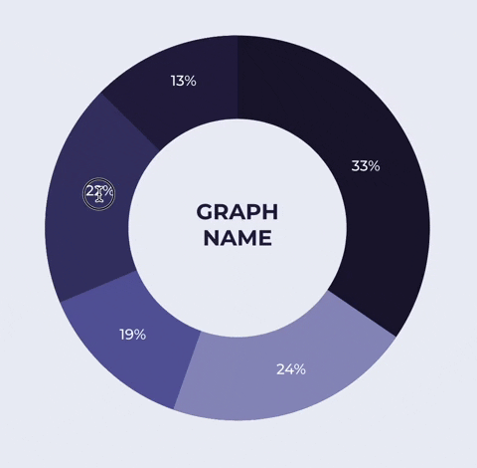
Graph header
13%
Graph explainer copy goes here. This can be formatted as a paragraph or bullets.
33%
22%
GRAPH
NAME
GRAPH INSTRUCTIONS, DELETE BEFORE PRESENTING.
• Edit your graph percentages like a normal text box.
• Select the edges of the shapes to adjust the size of each section.
• You can add or remove sections by making a copy of as existing section, and then recoloring it appropriately
• Take care to keep the shapes aligned to the center of the circle. Use Arrange>Align>Center to realign if you move a shape out of alignment.
19%
24%

Slide 22
Strength
Weakness
Add a quote here. Don’t forget to add some fun extra items, like quotes or this. More found at the end of this deck.
Add a quote here. Don’t forget to add some fun extra items, like quotes or this. More found at the end of this deck.
Opportunity
Cost
Add a quote here. Don’t forget to add some fun extra items, like quotes or this. More found at the end of this deck.
Add a quote here. Don’t forget to add some fun extra items, like quotes or this. More found at the end of this deck.

Slide 23
Invention, my dear friends, is 93% perspiration, 6% electricity, 4% evaporation, and 2% butterscotch ripple.
Willy Wonka
CEO & Founder, The Chocolate Factory

Slide 24

Invention, my dear friends, is 93% perspiration, 6% electricity, 4% evaporation, and 2% butterscotch ripple.
Willy Wonka
CEO & Founder, The Chocolate Factory

Slide 26
This slide is great for screenshots

Slide 27

Make a grand statement about security or whatever the heck you want!

Slide 28
Make a grand statement about security or whatever the heck you want!

Slide 29
Graph header
100%
98%
90%
90%
80%
70%
72%
60%
65%
Graph explainer copy goes here. This can be formatted at a paragraph or bullets.
50%
58%
40%
30%
20%
21%
10%

Slide 30
Pluralsight Skills services pricing
Insert header here
 | Tier 1 | Tier 2 | Tier 3 | Tier 4 | Custom
Section header | xxxx | xxxx | xxxx | xxxx | xxxx
Section header | xxxx | xxxx | xxxx | xxxx | xxxx
Section header | xxxx | xxxx | xxxx | xxxx | xxxx
Section header | xxxx | xxxx | xxxx | xxxx | xxxx
Section header | xxxx | xxxx | xxxx | xxxx | xxxx
Section header | xxxx | xxxx | xxxx | xxxx | xxxx
Section header | xxxx | xxxx | xxxx | xxxx | xxxx
Section header | xxxx | xxxx | xxxx | xxxx | xxxx
Section header | xxxx | xxxx | xxxx | xxxx | xxxx
Section header | xxxx | xxxx | xxxx | xxxx | xxxx
Notes:
We strive to be as transparent in our pricing as possible so you can feel confident in the services you’re receiving.
Please let me know if you have any questions on specific service prices that are shown here.

Slide 31




Onboarding timeline
Onboarding
Enterprise Onboarding
Week:
01
02
03
04
05
06
07
08
09
10
11
12
Header + Bullets + Bullets + Bullets
Header + Bullets + Bullets + Bullets
Header + Bullets + Bullets + Bullets
Header + Bullets + Bullets + Bullets
Notes:
Here’s a closer look at a typical Onboarding timeline
The typical timeline for this service is three months, or 12 weeks.
Our ProServ experts spend the first week pre-planning and meeting with key stakeholders to make sure we’re providing you with a tailored service
Next, you’ll enter the discovery phase, identifying roles and goals, planning the project and structuring your Skills account and licenses
Then, the execution phase will begin, where our experts begin integrating Skills into your org, testing your unique Skills strategy and enabling your admins and leaders
Lastly, the launch phase includes awareness campaigns, launch events and even a post-launch health check
The Onboarding service provides the best start to your experience with Skills

Slide 32
Strategy timeline
SECTION
SECTION
SECTION
SECTION
Title
Title
Title
Title
Title
Title
Title
Title
xxxx
xxxx
xxxx
xxxx
xxxx
xxxx
RESOURCES
xxxx
xxxx
DURATION
Time frame
Time frame
Time frame
Time frame
Time frame
Time frame
Time frame
Time frame
ACTIVITIES
Bullets
Bullets
Bullets
Bullets
Bullets
Bullets
Bullets
Bullets
Bullets
Bullets
Bullets
Bullets
Bullets
Bullets
Bullets
Bullets
Bullets
Bullets
Bullets
Bullets
Bullets
Bullets
Bullets
Bullets
Bullets
Bullets
Bullets
Bullets
Bullets
Bullets
Bullets
Bullets
Notes:
To help you visualize this service, here is an example timeline.

Slide 33
This is the header, it is long
This is the subhead, it is less important
First L
VP of Engineering, CloudHealth

Slide 34
This is the title placeholder! Yay! Woo hoo! We love it!
OPTIONAL SUBHEAD

Slide 35

This is a slide with 2 columns of bullets
Sections of bullets
Sentence fragments
List of things
Procedure list
Talking points
Sections of bullets
Sentence fragments
List of things
Procedure list
Talking points

Slide 36
This is a slide with 2 lists + icons
Sections of bullets
Longer bullets with a subhead to the left goes here
Keep these to ¾ bullets max
Icons here
Sections of bullets
Longer bullets with a subhead to the left goes here
Keep these to ¾ bullets max
Icons here

Slide 37
This slide has a minimal header treatment

Slide 38
This is the headline and it’s pretty cool
Subhead goes here

Slide 39
Graph header
13%
Graph explainer copy goes here. This can be formatted as a paragraph or bullets.
33%
22%
GRAPH
NAME
GRAPH INSTRUCTIONS, DELETE BEFORE PRESENTING.
• Edit your graph percentages like a normal text box.
• Select the edges of the shapes to adjust the size of each section.
• You can add or remove sections by making a copy of as existing section, and then recoloring it appropriately
• Take care to keep the shapes aligned to the center of the circle. Use Arrange>Align>Center to realign if you move a shape out of alignment.
19%
24%

Slide 40
Strength
Weakness
Add a quote here. Don’t forget to add some fun extra items, like quotes or this. More found at the end of this deck.
Add a quote here. Don’t forget to add some fun extra items, like quotes or this. More found at the end of this deck.
Opportunity
Cost
Add a quote here. Don’t forget to add some fun extra items, like quotes or this. More found at the end of this deck.
Add a quote here. Don’t forget to add some fun extra items, like quotes or this. More found at the end of this deck.

Slide 41
Invention, my dear friends, is 93% perspiration, 6% electricity, 4% evaporation, and 2% butterscotch ripple.
Willy Wonka
CEO & Founder, The Chocolate Factory

Slide 42
Invention, my dear friends, is 93% perspiration, 6% electricity, 4% evaporation, and 2% butterscotch ripple.
Willy Wonka
CEO & Founder, The Chocolate Factory

Slide 43
Invention, my dear friends, is 93% perspiration, 6% electricity, 4% evaporation, and 2% butterscotch ripple.
Willy Wonka
CEO & Founder, The Chocolate Factory

Slide 45
This slide is great for screenshots

Slide 46

Make a grand statement about security or whatever the heck you want!

Slide 47
Make a grand statement about security or whatever the heck you want!

Slide 48
Graph header
13%
Graph explainer copy goes here. This can be formatted as a paragraph or bullets.
33%
22%
GRAPH
NAME
GRAPH INSTRUCTIONS, DELETE BEFORE PRESENTING.
• Edit your graph percentages like a normal text box.
• Select the edges of the shapes to adjust the size of each section.
• You can add or remove sections by making a copy of as existing section, and then recoloring it appropriately
• Take care to keep the shapes aligned to the center of the circle. Use Arrange>Align>Center to realign if you move a shape out of alignment.
19%
24%

Slide 49
Graph header
13%
Graph explainer copy goes here. This can be formatted as a paragraph or bullets.
33%
22%
GRAPH
NAME
GRAPH INSTRUCTIONS, DELETE BEFORE PRESENTING.
• Edit your graph percentages like a normal text box.
• Select the edges of the shapes to adjust the size of each section.
• You can add or remove sections by making a copy of as existing section, and then recoloring it appropriately
• Take care to keep the shapes aligned to the center of the circle. Use Arrange>Align>Center to realign if you move a shape out of alignment.
19%
24%

Slide 50
Graph header
100%
98%
90%
90%
80%
70%
72%
Graph explainer copy goes here. This can be formatted as a paragraph or bullets.
60%
65%
50%
58%
40%
30%
58%
20%
10%

Slide 51
Graph header
100%
98%
90%
90%
80%
70%
72%
Graph explainer copy goes here. This can be formatted as a paragraph or bullets.
60%
65%
50%
58%
40%
30%
58%
20%
10%

Slide 52
Pluralsight Skills services pricing
Insert header here
 | Tier 1 | Tier 2 | Tier 3 | Tier 4 | Custom
Section header | xxxx | xxxx | xxxx | xxxx | xxxx
Section header | xxxx | xxxx | xxxx | xxxx | xxxx
Section header | xxxx | xxxx | xxxx | xxxx | xxxx
Section header | xxxx | xxxx | xxxx | xxxx | xxxx
Section header | xxxx | xxxx | xxxx | xxxx | xxxx
Section header | xxxx | xxxx | xxxx | xxxx | xxxx
Section header | xxxx | xxxx | xxxx | xxxx | xxxx
Section header | xxxx | xxxx | xxxx | xxxx | xxxx
Section header | xxxx | xxxx | xxxx | xxxx | xxxx
Section header | xxxx | xxxx | xxxx | xxxx | xxxx
Notes:
We strive to be as transparent in our pricing as possible so you can feel confident in the services you’re receiving.
Please let me know if you have any questions on specific service prices that are shown here.

Slide 53




Onboarding timeline
Onboarding
Enterprise Onboarding
Week:
01
02
03
04
05
06
07
08
09
10
11
12
Header + Bullets + Bullets + Bullets
Header + Bullets + Bullets + Bullets
Header + Bullets + Bullets + Bullets
Header + Bullets + Bullets + Bullets
Notes:
Here’s a closer look at a typical Onboarding timeline
The typical timeline for this service is three months, or 12 weeks.
Our ProServ experts spend the first week pre-planning and meeting with key stakeholders to make sure we’re providing you with a tailored service
Next, you’ll enter the discovery phase, identifying roles and goals, planning the project and structuring your Skills account and licenses
Then, the execution phase will begin, where our experts begin integrating Skills into your org, testing your unique Skills strategy and enabling your admins and leaders
Lastly, the launch phase includes awareness campaigns, launch events and even a post-launch health check
The Onboarding service provides the best start to your experience with Skills

Slide 54
Strategy timeline
SECTION
SECTION
SECTION
SECTION
Title
Title
Title
Title
Title
Title
Title
Title
xxxx
xxxx
xxxx
xxxx
xxxx
xxxx
RESOURCES
xxxx
xxxx
DURATION
Time frame
Time frame
Time frame
Time frame
Time frame
Time frame
Time frame
Time frame
ACTIVITIES
Bullets
Bullets
Bullets
Bullets
Bullets
Bullets
Bullets
Bullets
Bullets
Bullets
Bullets
Bullets
Bullets
Bullets
Bullets
Bullets
Bullets
Bullets
Bullets
Bullets
Bullets
Bullets
Bullets
Bullets
Bullets
Bullets
Bullets
Bullets
Bullets
Bullets
Bullets
Bullets
Notes:
To help you visualize this service, here is an example timeline.

Slide 55
Questions?

Slide 56
Extra resource elements to make your deck pop

Slide 57




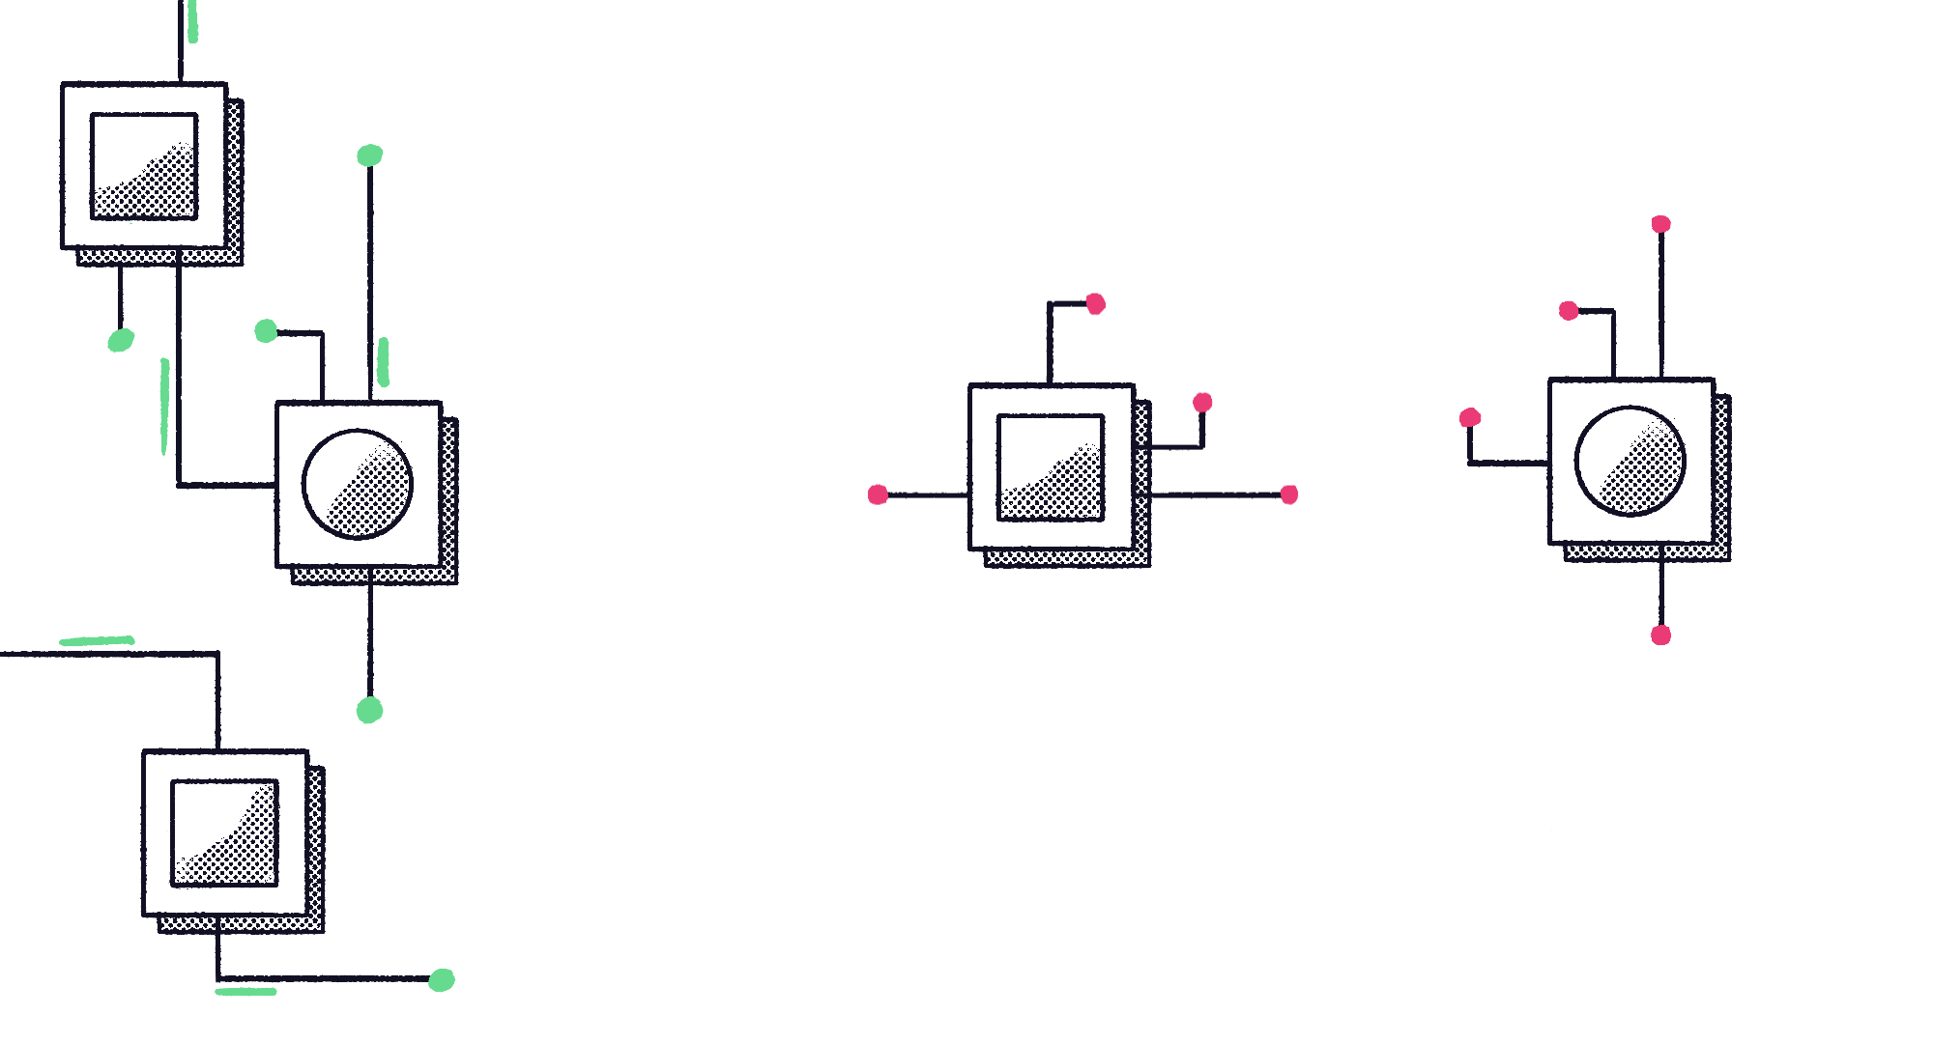


Illustrations

Slide 58


Illustrations

Slide 59





































































Presentation icons

Slide 60

















































Presentation icons

Slide 61


















































Presentation icons

Slide 62


















































Presentation icons

Slide 63








































Presentation icons

Slide 64





































































Presentation icons

Slide 65


















































Presentation icons

Slide 66















































Presentation icons

Slide 67

















































Presentation icons

Slide 68









































Presentation icons

Slide 69








Background textures

Slide 70

Background textures

Slide 71

Background textures

Slide 72

Background textures

Slide 73







Background textures

Slide 74

Background textures

Slide 75

Background textures

Slide 76

Background textures

Slide 77

Background textures

